Slide 1
Office 365 Development

Slide 2
Course Agenda
Deep Dive into Integrating Office 365 APIs with Web Applications
Module 1: Deep dive into Mobile Development with Office 365 and Cordova
Module 2: Deep dive into native Universal Windows App Development with Office 365 APIs
Module 3: Deep dive into native Xamarin Development with Office 365 APIs

Slide 3
Deep dive into Mobile Development with Office 365 and Cordova
Speaker
Speaker

Slide 4

Agenda
Cordova Overview
Developing a Cordova App
Cordova Apps and Office 365

Slide 5
Overview

Slide 6
What is a Hybrid App
An app created with HTML5, CSS3 and JavaScript
Available through an app store
Different than a mobile web site
Hybrid app runs in browser of mobile device
Chromeless (no browser title bar, navigation buttons, etc.)
HTML, CSS and JavaScript downloaded and run locally from device
App launched in full screen mode
User isn’t aware that app is using browser

Slide 7
What is Cordova
An open source collection of JavaScript device APIs
Abstracts away device specific APIs
Toolsets built on top of Cordova
PhoneGap (Abode)
AppBuilder (Telerik)

Slide 8
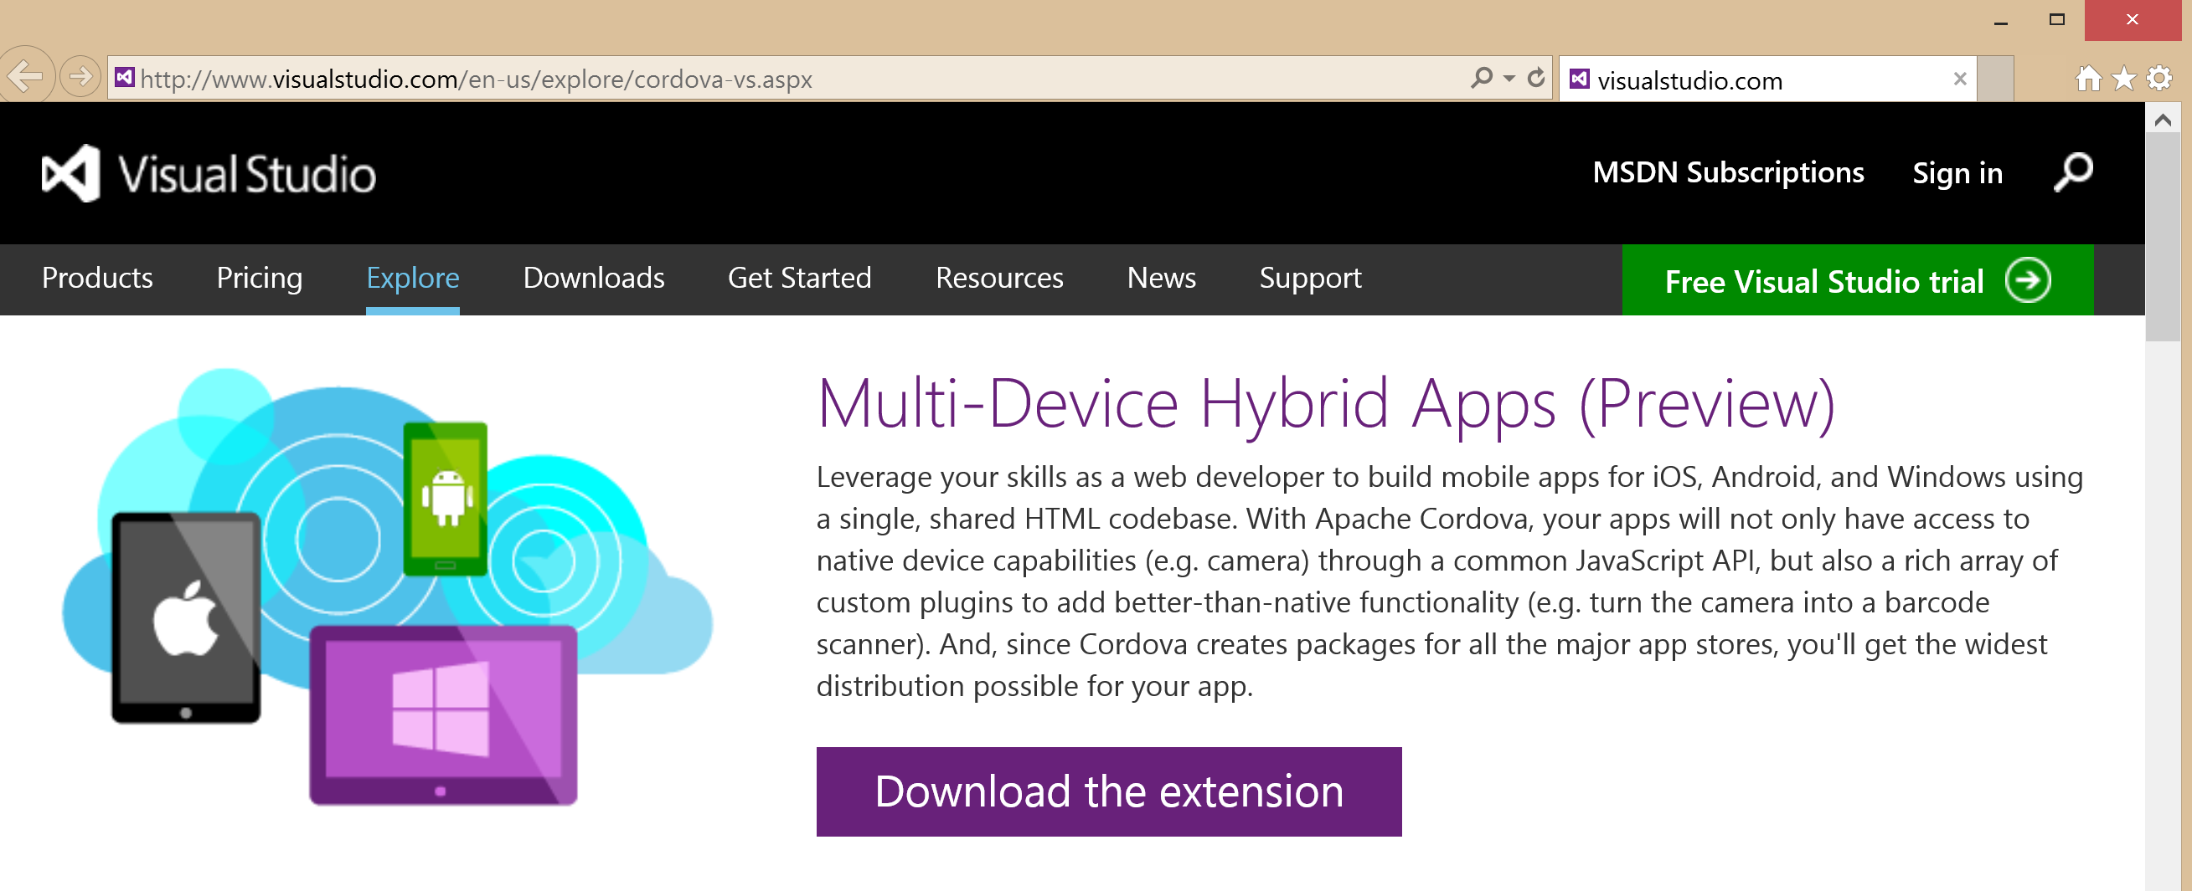
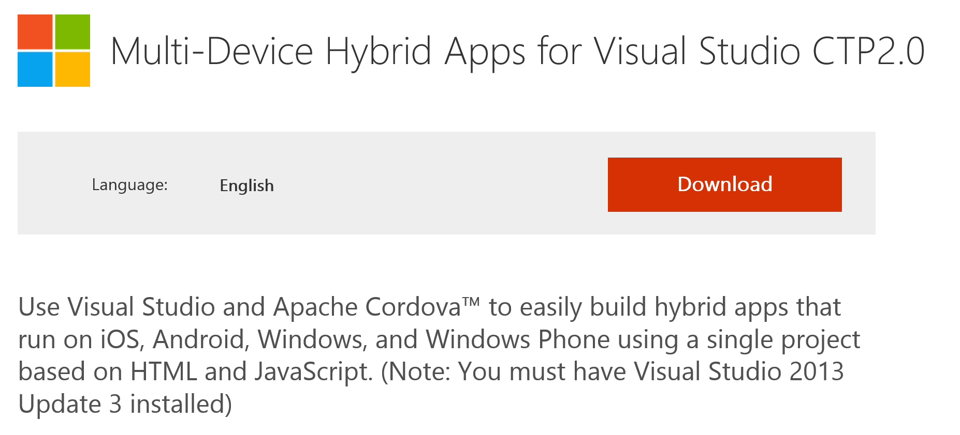

Slide 9
Supported Platforms
You can use the extension to build apps for the following devices and platforms:
Android 4 and later (4.4 provides the best developer experience)
iOS 6 and iOS 7
Windows 8 (Windows Store)
Windows Phone 8

Slide 10
Visual Studio Assistance
Easy installation.
Building and running apps using Cordova requires third-party software, especially to support multiple native platforms. Visual Studio handles all that for you by including a third-party dependency installer that gets you up and running in the first hour.
Plugin management.
Cordova plugins provide access to native APIs using a JavaScript interface. Support for custom plugins like those that turn a mobile phone into a barcode scanner are critical to an app's success. Visual Studio makes it easy to add plugins of all kinds, including core Cordova and custom plugins. You also benefit from IntelliSense for plugins in Visual Studio.
Unified debugging experience.
Multi-device development often requires a different tool for debugging each device, emulator, or simulator. Different tools mean different workflows and lost productivity every time you switch devices. With Visual Studio, you can use the same world-class debugging tools for all deployment targets, including Windows, the Android emulator, attached Android devices, Apache Ripple, and (coming soon) iOS devices and emulators.
Write once, deploy everywhere.
The common JavaScript and plugin APIs in Cordova make it easy to write an app using a single code base that deploys to all target platforms—iOS, Android, and Windows. Of course, you can always write platform-specific code if and when you need it.

Slide 11
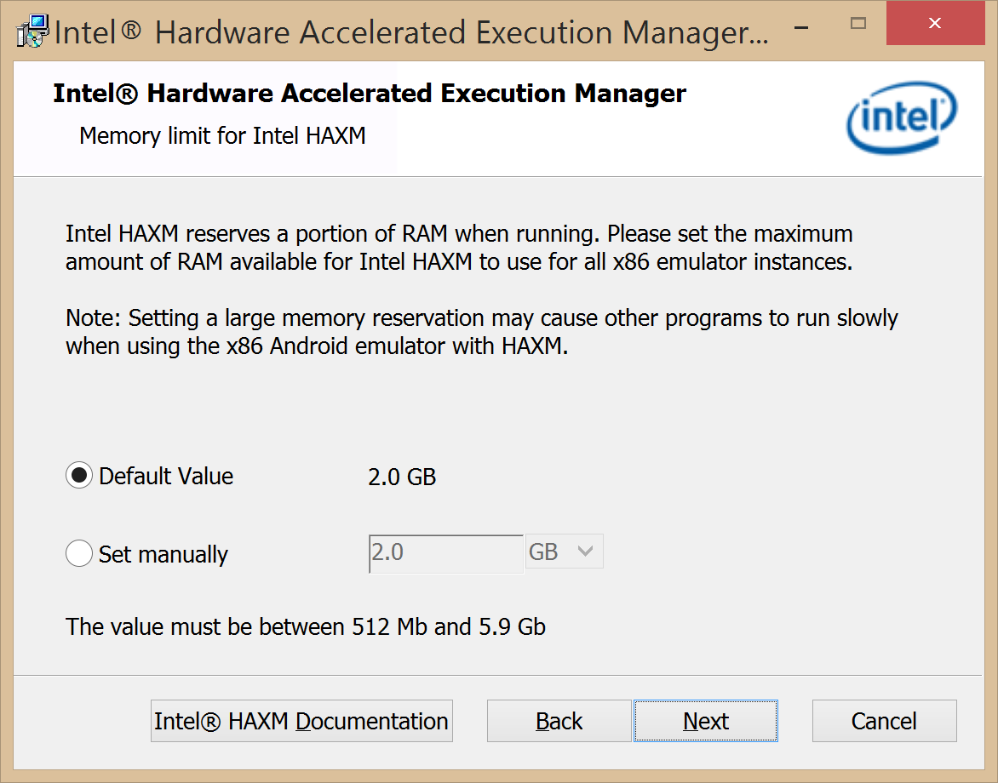

Slide 12
Setup
Go here
http://msdn.microsoft.com/en-us/library/dn757054.aspx
Highlights
Windows 8.1 or Windows Server 2012 R2
Visual Studio 2013 with Update 3

Slide 13
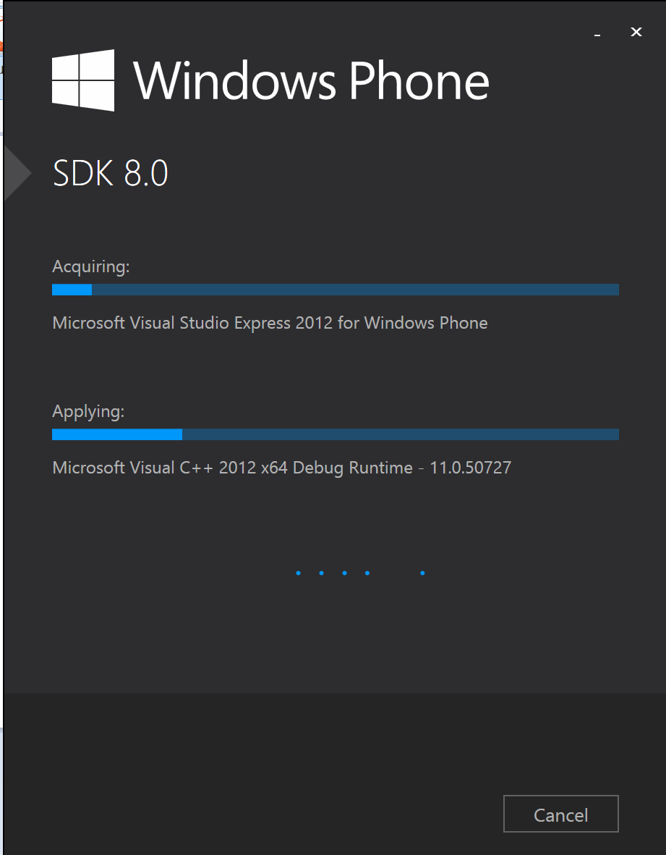

Slide 14
Android Emulators and Debugging
Apache Ripple emulator
Android emulator
Genymotion emulator
Android device

Slide 20
Office 365 Exchange APIs
Office 365 Exchange APIs
Mail Message API
Calendar Events API
Contacts API
Office Exchange APIs accessible through REST
https://outlook.office365.com/ews/odata/Me/Inbox/Messages
https://outlook.office365.com/ews/odata/Me/Events
https://outlook.office365.com/ews/odata/Me/Contacts
Office Exchange APIs accessible ExchangeClient
A library which abstracts away sending and receiving REST request

Slide 21
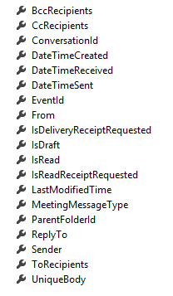
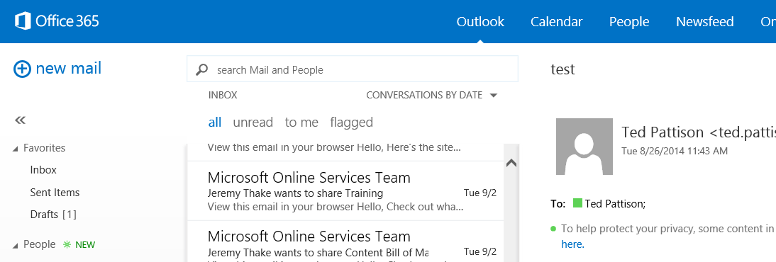
Mail Messages
Message
Common API operations
Reading messages
Deleting messages
Sending messages
Working with attachments

Slide 22
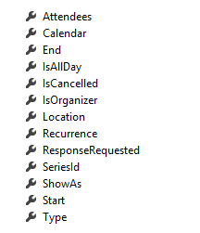
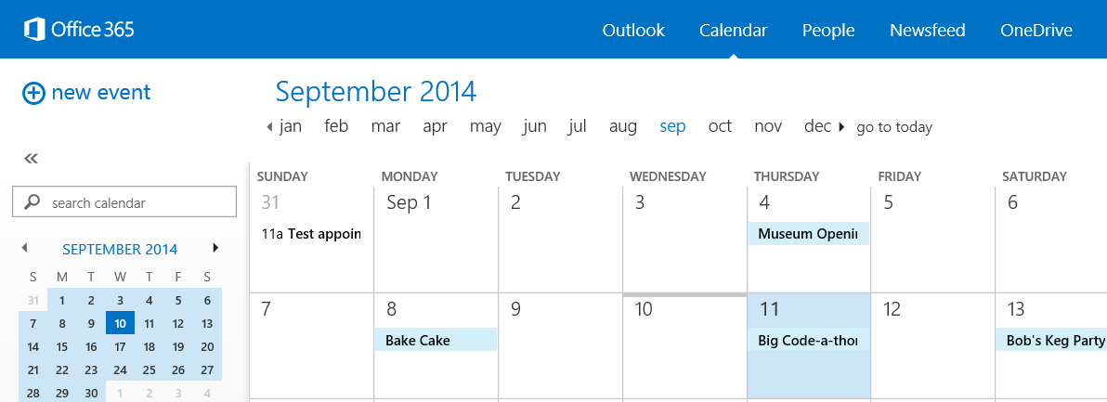
Calendar Events
Common API operations
Reading events for specific date range
Creating events
Deleting events
Editing events
Event

Slide 23
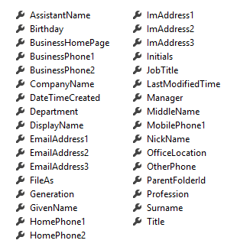
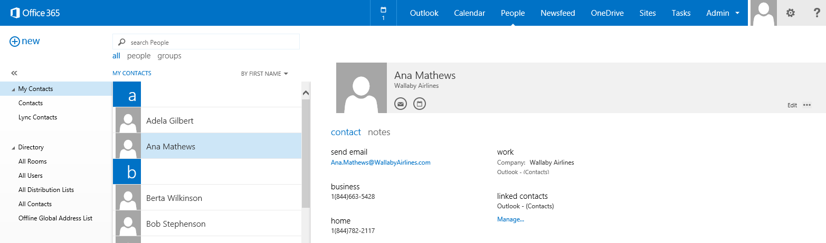
Contacts
Common API operations
Reading contacts
Searching for contacts
Creating contacts
Deleting contacts
Editing events
Contact

Slide 24
Connected Services

Slide 25
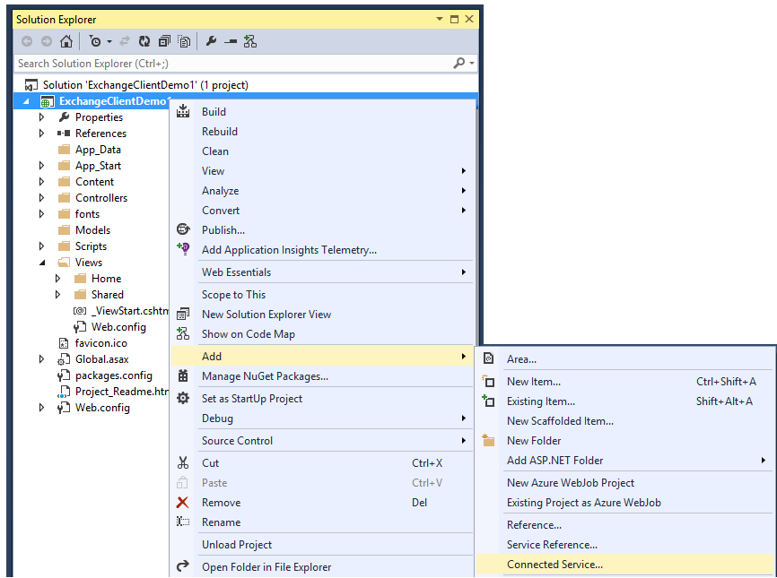
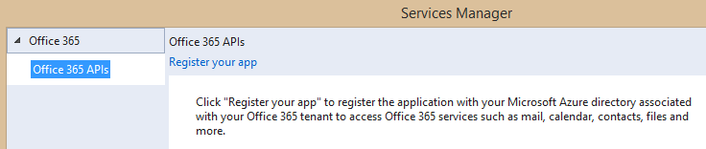
Adding Connected Services
1
Project > Add > Connected Service…
2
Register your app

Slide 26
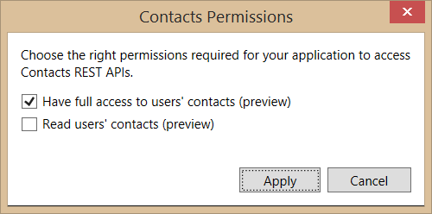
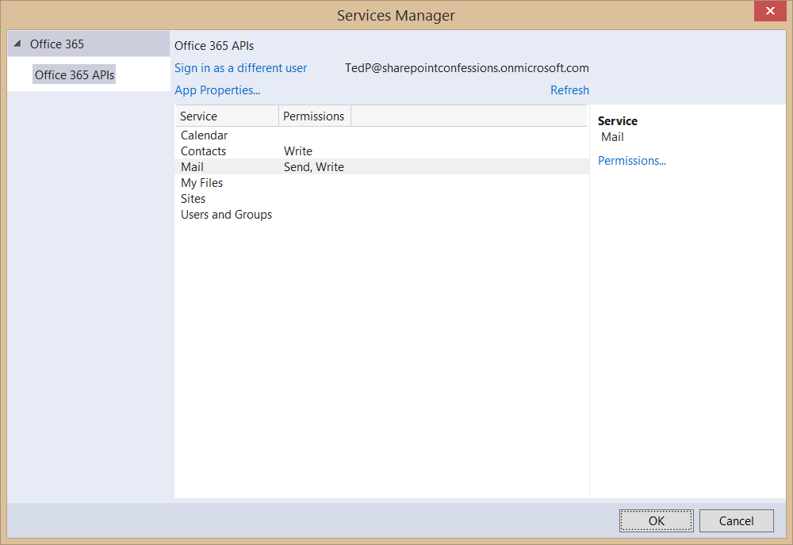
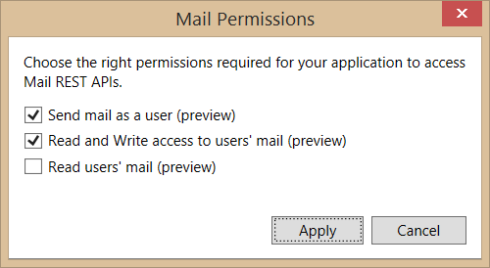
Connected Services Permissions
3
Select required app permissions

Slide 27
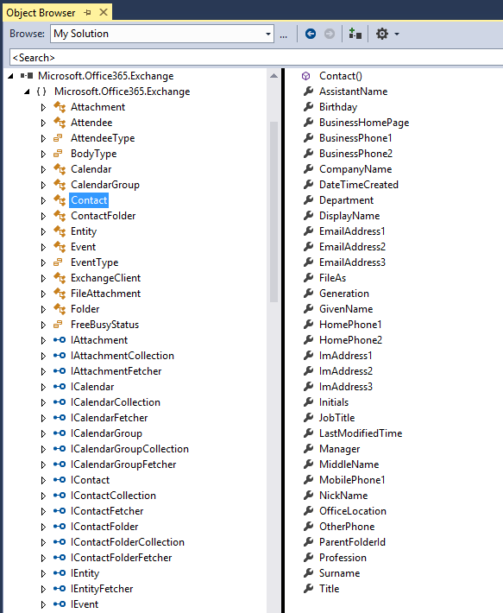
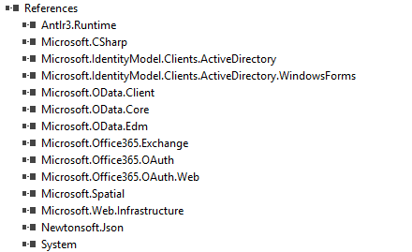
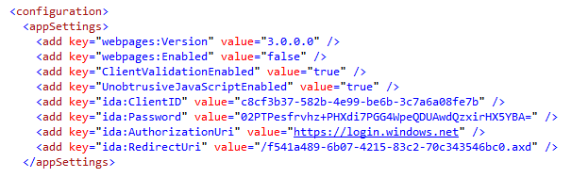
Projects with Connected Services
Assemblies added with a Connected Service
Microsoft.Office365.OAuth
Microsoft.Office365.Oauth.Web
Microsoft.Office365.Exchange
AppSettings added with a Connected Service

Slide 28
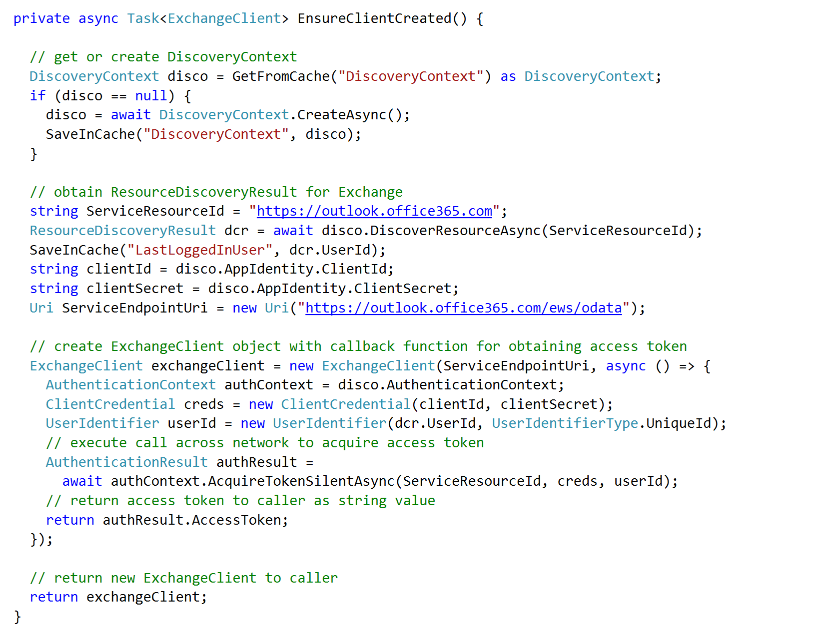
Discovery service resource using DiscoverResourceAsync
Retrieve access token using AcquireAccessTokenSlientAsync

Slide 29
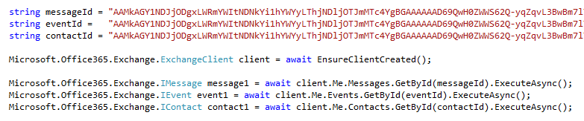
Programming with ExchangeClient
ExchangeClient provide Me property
Provides access to mail, events and contacts of currently logged in user
Explicit calls used (e.g. ExecuteAsync) to call across network to Office 365 service

Slide 30
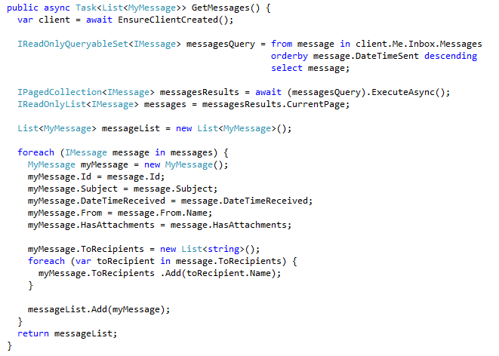
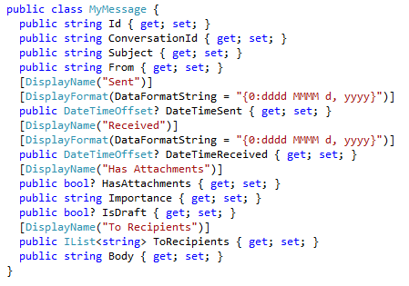
Retrieving Messages

Slide 31
demo
Creating an MVC Project that uses Connected Services

Slide 32
Paging Support

Slide 33
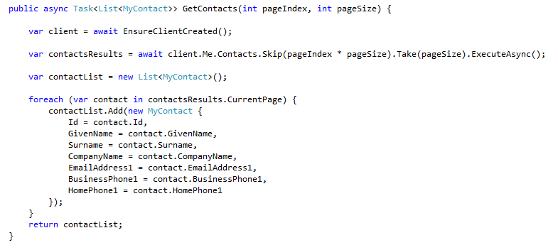
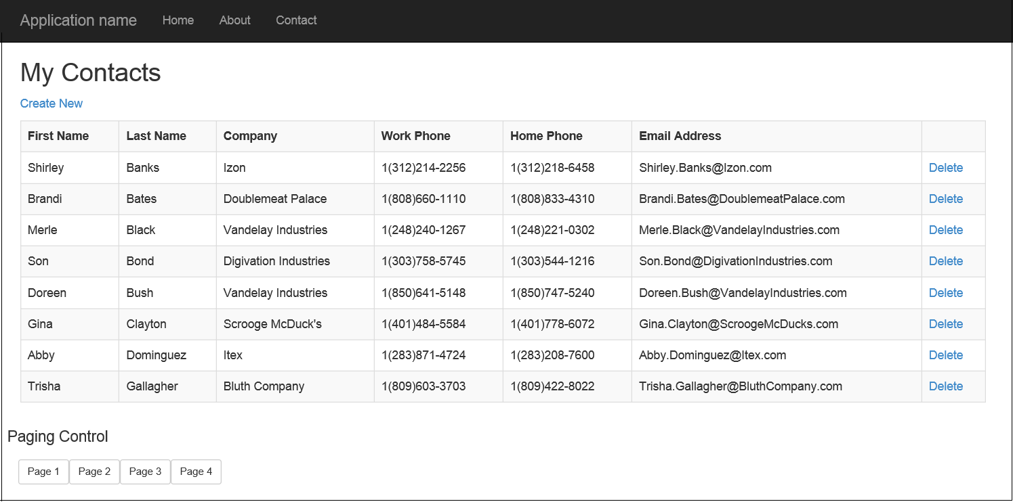
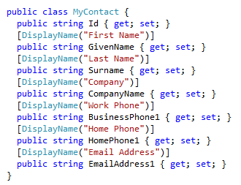
Paging with the Office 365 APIs
Limit the number of items returned by using the Take() and Skip() prior to ExecuteAsync()
Paging buttons call GetContacts which skips over the specified number of contacts to present the next page

Slide 34
demo
Examining Paging Support with ExchangeClient

Slide 35
CRUD Support

Slide 36
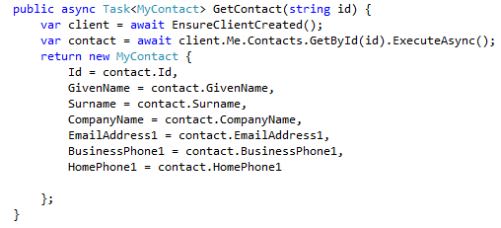

Getting and Deleting a Specific Contact
Contact retrieved by calling GetById()
Contact deleted by calling DeleteAsync() on Contact object

Slide 37
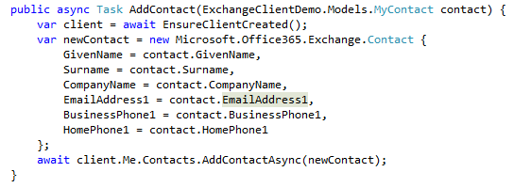
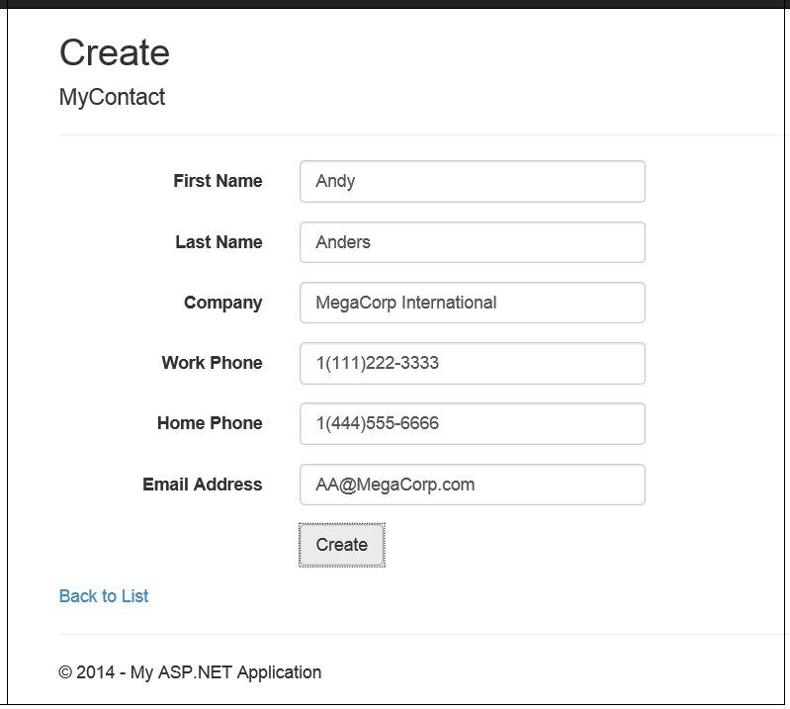
Adding a Contact
Call AddContactAsync() on Contacts collection

Slide 38
demo
Update operations with the EXCHANGEClient

Slide 39
Exchange Operations with REST

Slide 40
Office 365 Exchange REST APIs
https://outlook.office365.com/ews/odata/Me/RootFolder
https://outlook.office365.com/ews/odata/Me/Inbox
https://outlook.office365.com/ews/odata/Me/Inbox(<message_id>)
https://outlook.office365.com/ews/odata/Me/Drafts
https://outlook.office365.com/ews/odata/Me/SentItems
https://outlook.office365.com/ews/odata/Me/DeletedItems
https://outlook.office365.com/ews/odata/Me/Events
https://outlook.office365.com/ews/odata/Me/Events(<event_id>)
https://outlook.office365.com/ews/odata/Me/Calendar
https://outlook.office365.com/ews/odata/Me/Calendar/Events
https://outlook.office365.com/ews/odata/Me/Calendars(<calendar_id>)/Events
https://outlook.office365.com/ews/odata/Me/Contacts
https://outlook.office365.com/ews/odata/Me/Contacts(<contact_id>)

Slide 41
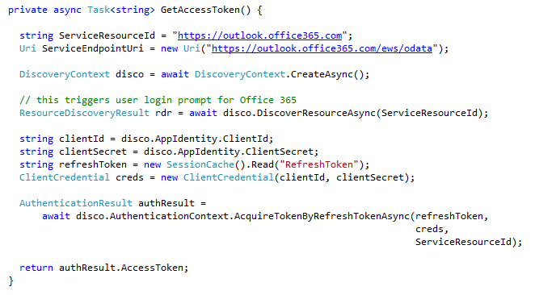
Obtaining an Access Token
Use Discovery Service to get an Access Token

Slide 42
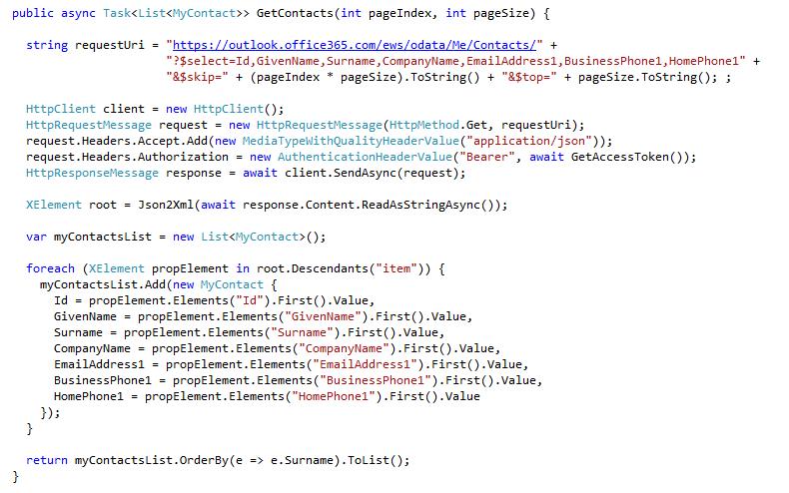
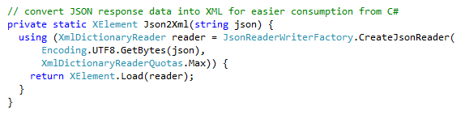
Reading Contacts using REST
Send GET request to Contacts endpoint
Office 365 Exchange API only returns JSON responses
Paging is accomplished using $skip and $top
Notes:
No support for $skip and $orderby so paging is post-query

Slide 43
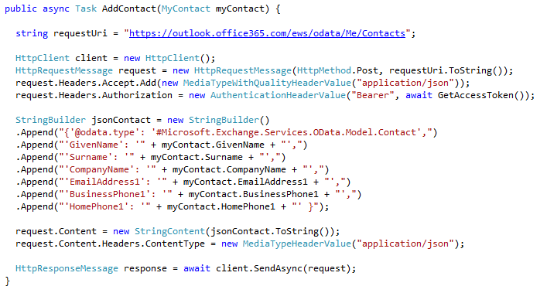
Adding a new Contact
POST to Add endpoint
Provide minimum of @data.type and GivenName property

Slide 44
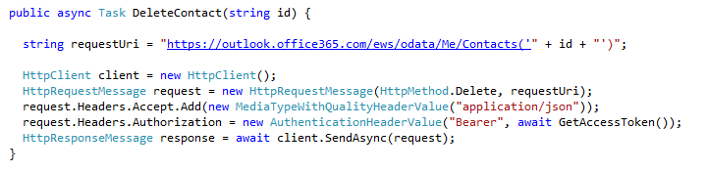
Deleting a Contact
DELETE operation targeting Me/Contacts(Id)

Slide 45
demo
Exchange Operations using the Office 365 REST APIs

Slide 46
Summary
Overview
Connected Services
Paging Support
CRUD Support
Exchange Operations using REST

Slide 47

© 2012 Microsoft Corporation. All rights reserved. Microsoft, Windows, and other product names are or may be registered trademarks and/or trademarks in the U.S. and/or other countries.
The information herein is for informational purposes only and represents the current view of Microsoft Corporation as of the date of this presentation. Because Microsoft must respond to changing market conditions, it should not be interpreted to be a commitment on the part of Microsoft, and Microsoft cannot guarantee the accuracy of any information provided after the date of this presentation. MICROSOFT MAKES NO WARRANTIES, EXPRESS, IMPLIED OR STATUTORY, AS TO THE INFORMATION IN THIS PRESENTATION.

